Slide 1

HYBRID INTRUSION DETECTION SYSTEM USING MACHINE LEARNING
Presented by-
Sharath L R (4NN15CS042)
Nishchith J Hegde (4NN15CS025)
Prajwal N (4NN15CS028)
Ajaykrishnan S (4NN15CS007)
Guided by-
Smt. Vedhavathi N
(Assistant Professor CSE)

Slide 2
ABSTRACT
Intrusion Detection Systems play a crucial role in defending computer networks. However, there concerns regarding feasibility and sustainability of current approaches when faced with the demands of modern networks. More specifically, these concerns relate to the increasing levels of required human interactions and the decreasing levels of detection accuracy. Intrusion Detection System most commonly used in enterprise networks are signature based, because they can efficiently detect known attacks while generating a relatively low number of false positives. As technology has been developed many threats are emerged for the data and network security which is not all good for sensitive data transactions, but as network security also possess equal importance in the computer infrastructure. Thus to overcome this we are proposing this project which is based on machine learning algorithms and techniques.

Slide 3
INTRODUCTION
Dangerous hackers are inventing new techniques in a daily basis to bypass security layers and avoid detection. Thus it is time to figure out new techniques to defend against cyber threats. Intrusion detection systems are a set of devices or pieces of software that play a huge role in modern organizations to defend against intrusions and malicious activities.
The detection can be done using two intrusion detection techniques:
Signature based detection technique: the traffic is compared against a database of signatures of known threats
Anomaly-based intrusion technique: inspects the traffic based on the behavior of activities.

Slide 4
EXISTING WORK
SL NO. | TITLE | AUTHORS | YEAR | METHODOLOGY | MERITS | DEMERITS
1 | Classification of attack types for intrusion detection system using machine learning algorithms | -Kinam park -Youngrok song -Yun-Gyung Cheong | 2018 | -Class specific Detection -Random Forest Algorithm -kyoto2006+ dataset | Overall performance is good enough to reach 0.99of F1 score for all evaluation metrics | Data is highly unbalanced. The detection of shellcode attack shows a poor performance as low as 0.16 of F1 score
2 | An Intrusion Detection System using Machine Learning Algorithm | -Chibuzor John Ugochukwu -E.O Bennett | 2018 | -WEKA Scripting Software -Bayes Net, J48 Random Forest and Random Tree algorithms -KDDCup99 dataset | Random forest and Random tree algorithms are more efficient in performing classification | Older dataset used
3 | Intelligent Intrusion Detection System using Artificial Neural Networks | -Alex Shenfield -David Day -Aladdin Ayesh | 2018 | -signature based -Artificial Neural Network | False positive rate of less than 2% | Detecting only shellcode

Slide 5
PROBLEM STATEMENT
Project is a Hybrid Intrusion Detection System (HIDS)
Flow based intrusion detection approach is implemented in which, the communication patterns within the network are analysed, instead of contents of individual packets.
HIDS contains two module
one module for anomaly based detection
second module for signature based detection
Neural networks is used to implement detection techniques along with Ensemble learning increase detection rate.
Standard dataset KDDCup99 was used in train and test the ML models. It has 41 features and 22 classes of attack.

Slide 6
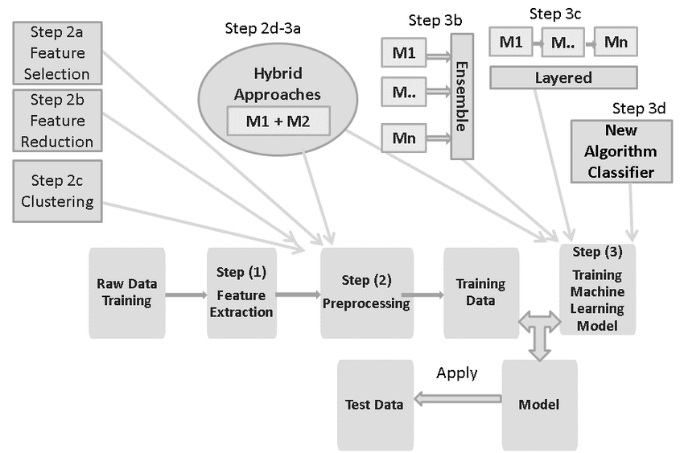
SYSTEM ARCHITECTURE

Slide 7
DATA FLOW DIAGRAM
Network
Sniffed data packet
Converted into the input form for a anomaly based model
KDDCup99 data
Anomaly based module
Signatures
comparison
normal data packet
signatures
malicious data
packet
Continue normal flow
signatures
Signature based module
train found new signatures to signature based module
Alerting system
Malicious request

Slide 8
IMPLEMENTATION:
Stage 1: Data Selection, Pre-processing and Transformation:
KDDCup99 dataset is selected
It has 41 features for each record
22 classes of attack are recorded in the dataset
Dataset is processed, which removes duplicate rows and empty rows
Some features of datasets are label encoded
Standard scalers and normalizers are used to transform dataset.
Stage 2: Creating training and testing sets for ML models
For anomaly based model , dataset is binary classified where all attacks are considered as single class
For signature based model, only attack records are used.

Slide 9
Stage3: Implementing algorithms and Creating training models:
For anomaly model,
-> Binary classification ANN model is trained for attack and normal classes
-> Along with sigmoid and ReLU activations, loss function binary cross entropy is also used in the algorithm.
For signature model,
-> Multi classification CNN, GRU, DNN, LSTM and RNN models are trained for 22 classes of attack
-> Along with SoftMax and ReLU activation, loss function categorical cross entropy is also used in the algorithms
-> Ensemble learning technique weighted majority voting is used to combine results of above five algorithms to get a better and accurate prediction of signature of attacks.

Slide 10
Stage4: Training:
Training the model with training dataset.
Stage5: Testing:
Testing the model with training dataset.
Testing the model with testing dataset
Stage6: Performance evaluation:
Classification report
Confusion matrix
Scatter plot
Stage7: Partial fit and alerting
Partial fitting of predictions of the model to increase detection rate
To handle variations of attack
Alerts are generated along with attack type

Slide 11
TESTING RESULTS:
ML MODELS | ACCURACY | PRECISION | F1 SCORE
ANN | 0.98 | 0.99 | 1.00
CNN | 0.99 | 0.98 | 1.00
DNN | 0.97 | 0.98 | 1.00
GRU | 0.98 | 0.99 | 1.00
RNN | 0.97 | 0.97 | 1.00
LSTM | 0.98 | 0.98 | 1.00
ENSEMBLE OF CNN, DNN, GRU, RNN & LSTM | 0.98 | 0.98 | 1.00

Slide 12
Advantages
Hybrid system containing anomaly and signature based models
It employs ensemble machine learning technique, weighted majority voting to improve predictions of signature model
Partial fitting improve predictions of model with experience
Accuracy of our system is around 98-99%

Slide 13
Conclusion:
The two stage sequentially deployments of misuse detection and anomaly detection is time and resource conserving. First known attacks have been detected easily and quickly with the neural networks. This is fast as the testing must be done only for the packet. The novel attacks have been detected separately using anomaly detection. But this requires a collection of packets for the clustering algorithm. Further the anomaly detection can be misled if the attack packets exceed the normal packets. So, the unclassified packets during the misuse detection merge with known normal packets to form a dataset for anomaly detection. This ensures that the anomaly detection system is not misled by the relatively large occurrence of an anomaly.

Slide 14
Future Enhancement:
In future, it is possible to provide extensions or modifications to the proposed clustering and classification algorithms in ensemble using intelligent agents to achieve further increased performance. Apart from the machine learning techniques combination of data mining techniques, further combinations such as artificial intelligence, soft computing and other clustering algorithms can be used to improve the detection accuracy and to reduce the rate of false negative alarm and false positive alarm. Finally, the intrusion detection system can be extended as an intrusion prevention system to enhance the performance of the system. In future, Intrusion detection system can improved to Intrusion prevention system.

Slide 15
Reference:
[1] Kinam Park, Youngrok Song and Yun-Gyung Cheong (2018), Classification of Attack Types for Intrusion Detection Systems using a Machine Learning Algorithm, 2018 IEEE Fourth International Conference on Big Data Computing Service and Applications.
[2] Chibuzor John Ugochukwu, & E. O Bennett (2018), An Intrusion Detection System Using Machine Learning Algorithm, International Journal of Computer Science and Mathematical Theory ISSN 2545-5699 Vol. 4 No.1 2018.
Websites :
stackoverflow
github
giks for giks

Slide 16


